Slide 1
The True Meaning behind “Decision Day!”
Edward Gates, Jr.
Philip Nunoo
Nikita Jones
Mason Waters

Slide 2
Presentation Requirements
* [ ] Be at least 8-10 min.long
* [ ] Describe the core message or hypothesis for your project.
* [ ] Describe the questions you and your group found interesting, and what motivated you to answer them
* [ ] Summarize where and how you found the data you used to answer these questions
* [ ] Describe the data exploration and cleanup process (accompanied by your Jupyter Notebook)
* [ ] Describe the analysis process (accompanied by your Jupyter Notebook)
* [ ] Summarize your conclusions. This should include a numerical summary (i.e., what data did your analysis yield), as well as visualizations of that summary (plots of the final analysis data)
* [ ] Discuss the implications of your findings. This is where you get to have an open-ended discussion about what your findings "mean".
* [ ] Tell a good story! Storytelling through data analysis is no different than in literature. Find your narrative and use your analysis and visualization skills to highlight conflict and resolution in your data.

Slide 3
Does your degree matter??
Transition

Slide 4
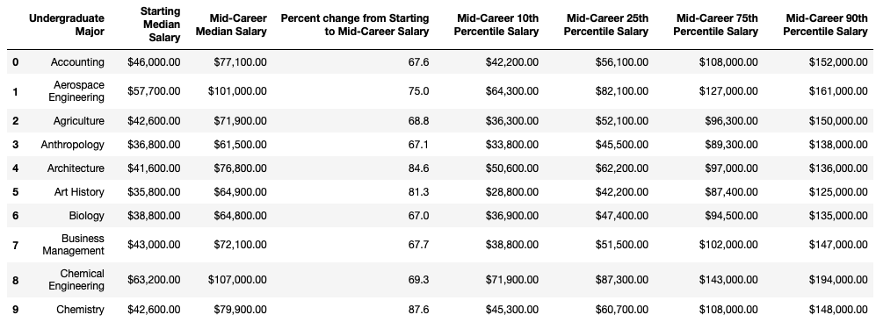
Degrees that pay back – Data Preview

Slide 5
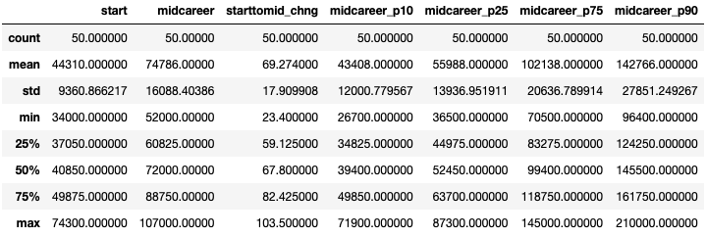
Overall Descriptive Statistics

Slide 6
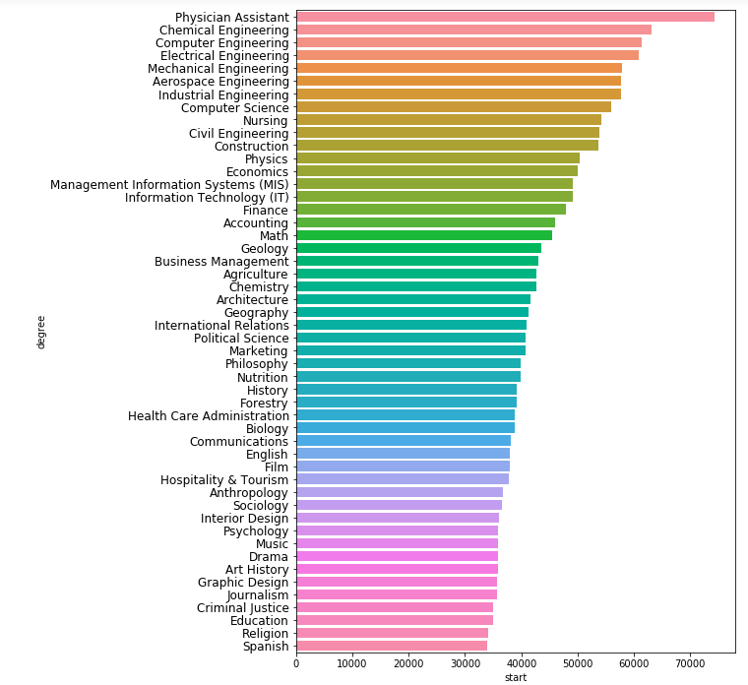
Which Undergraduate Majors get the highest income at the start of their careers?
Top 5
Physician Assistant: $74,300
Chemical Engineering: $63,200
Computer Engineering: $61,400
Electrical Engineering: $60,900
Mechanical Engineering: $57,900
Bottom 5
Spanish: $34,000
Religion: $34,100
Education: $34,900
Criminal Justice: $35,000
Journalism: $35,600

Slide 7
Which Undergraduate Majors get the highest income at Mid-Career?
Top 5
Chemical Engineering: $107,000
Computer Engineering: $105,000
Electrical Engineering: $103,000
Aerospace Engineering: $101,000
Economics: $98,600
Bottom 5
Religion: $52,000
Education: $52,000
Spanish: $53,100
Interior Design: $53,200
Music: $55,000

Slide 8
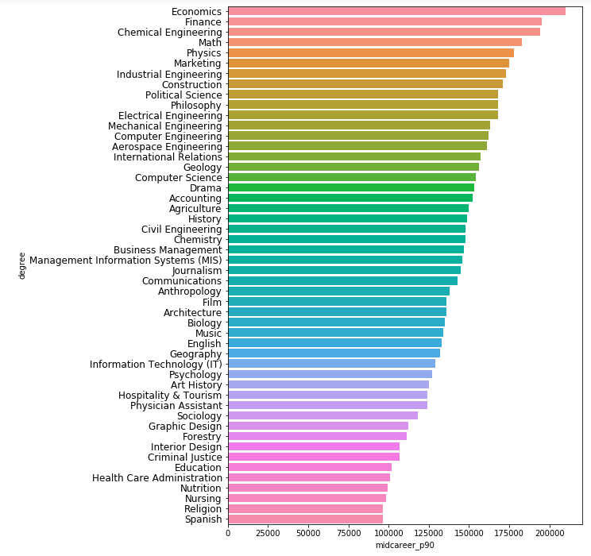
Which Undergraduate Majors get the highest income at Mid-Career 90th Percentile?
Top 5
Economics: $210,000
Finance: $195,000
Chemical Engineering: $194,000
Math: $183,000
Physics: $178,000
Bottom 5
Spanish: $96,400
Religion: $96,400
Nursing: $98,300
Nutrition: $99,200
Healthcare Administration: $101,000

Slide 9
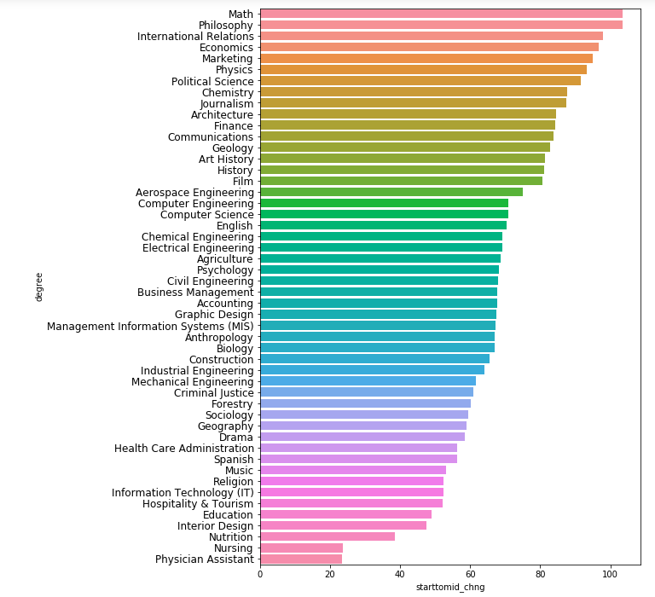
Percent change from Starting to Mid-Career Salary
Top 5
Math: 103.5%
Philosophy: 103.5%
Economics: 97.8%
Marketing: 96.8%
Physics: 95.1%
Bottom 5
Physician Assistant: 23.4%
Philosophy: 23.4%
Economics: 38.6%
Marketing: 47.4%
Physics: 49%

Slide 10
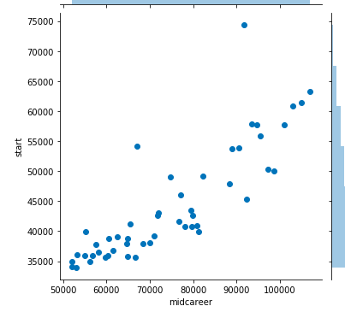
Starting vs. Mid-Career Median Salary
Pearson Correlation: 0.85

Slide 11
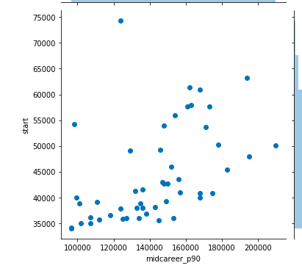
Starting vs. Mid-Career 90th Percentile Median Salary
Pearson Correlation: 0.70

Slide 12
Summary Write-Up
Physician Assistants start their career noticeably with the best salary.
In the middle of the career, Chemical Engineers and then Computer Engineers get the best salary.
In the long term, Economists have the salary advantages who earns the best salary when compared to others.
Mathematicians and Philosophers have the most increase in their salary during their career.
As a result of analyzes we have made, different jobs have different advantages in their career opportunities when start salary, long term salary and increase in salary percentage compared.

Slide 13
?
Any questions?
?
?

